Slide 1
Mt. Rumpke Children’s Hospital
A Market Research Report:
Test the giving environment in the local and national areas
Consider key messages and how they are received

Slide 2
Research Objective & Data Collection Methods
Research Objective
Develop and follow messages for target audiences that can be incorporated throughout marketing and development communications. Inform marketing and communications plans and materials, as well as development communications for Mt. Rumpke Children’s Hospital. Determine the preferred method of communication for audiences of different ages and demographics to aid in planning a comprehensive communication strategy.
Data Collection Methods
Quantitative – Survey
Qualitative – Focus Groups

Slide 3
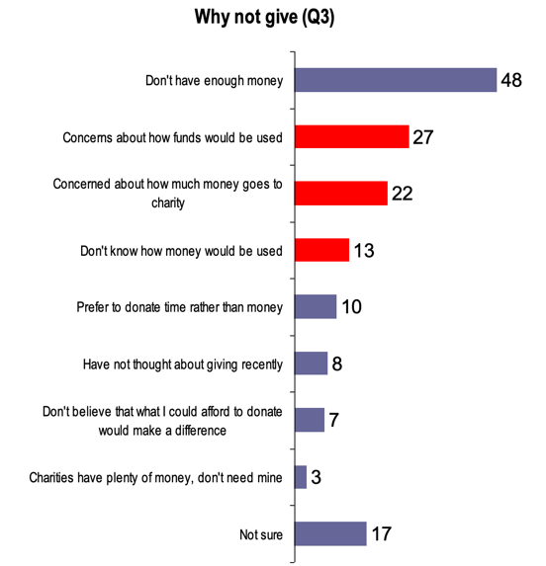
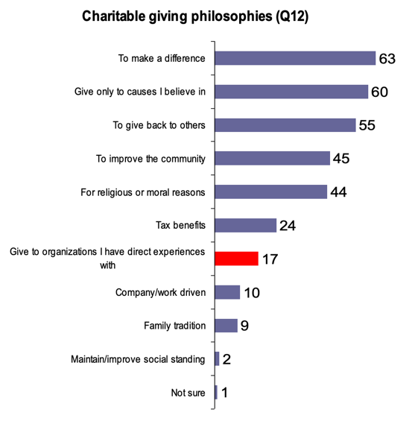
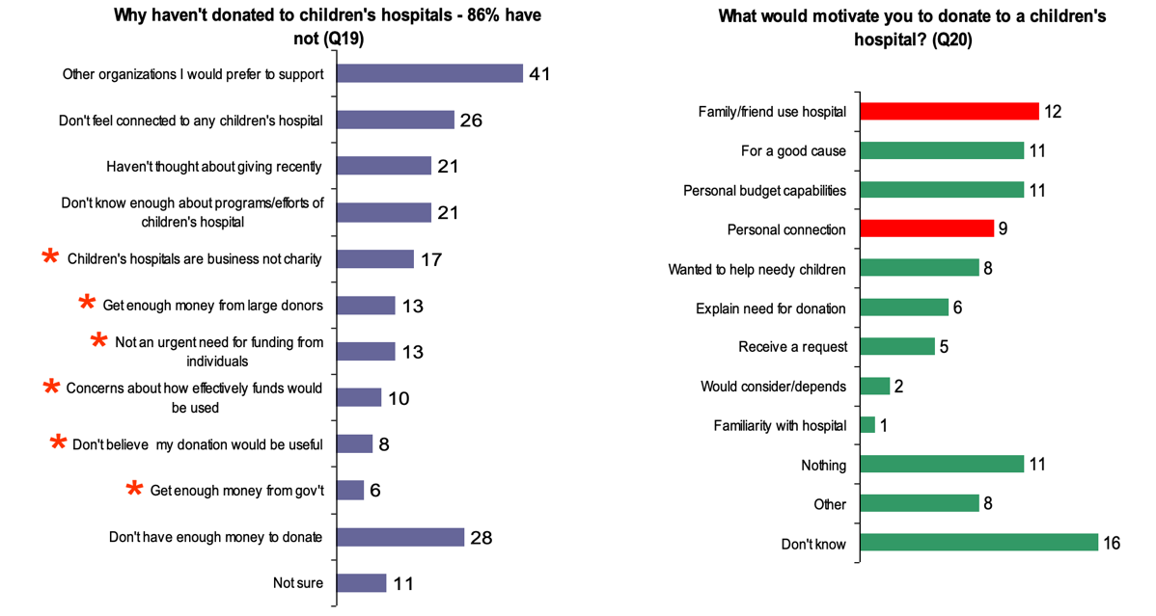
Research Outcomes
The four charts below highlight the outcomes of our research.
(from left to right) – Reasons for not giving, Reasons for giving, Reasons that would motivate to give.

Slide 4
Key Findings
Overall
Nice City MSA people are most likely to give only to causes in which they believe.
Almost half of the people in the four-state area say that no specific request appeals to them.
Mail solicitations remain the single most effective appeal – specifically with previous donors.
A quarter of all people in these four states feel that children’s hospitals get enough money from major donors and thus don’t need their money.
Universities and schools are not seen as needing money from people like these.
Key Statistics
1/5 people who have donated to a children’s hospital have done so because of an experience with the hospital.
8% of donators do so because of a working relationship with the hospital or at least healthcare.
40% of people give to children’s hospitals because they believe in their mission; and it does not matter if they have children or not.
Key Messages
“Annie is alive/thriving today because of past donations that helped us.”
“Every gift matters. Contributions of any size combine for big impact.”
“Charitable giving accelerates our efforts – resulting in better treatments sooner.”

Slide 5

Recommendations
FOCUS
On patient care in donation appeals
ADAPT
Key messages to show why people should BELIEVE in the work being done at Mt. Rumpke Children’s Hospital
PROVIDE
Greater clarity on how funds are being used
EDUCATE
People on why children’s hospitals need donations
OFFER
Stories and case studies from real-life

